Slide 1
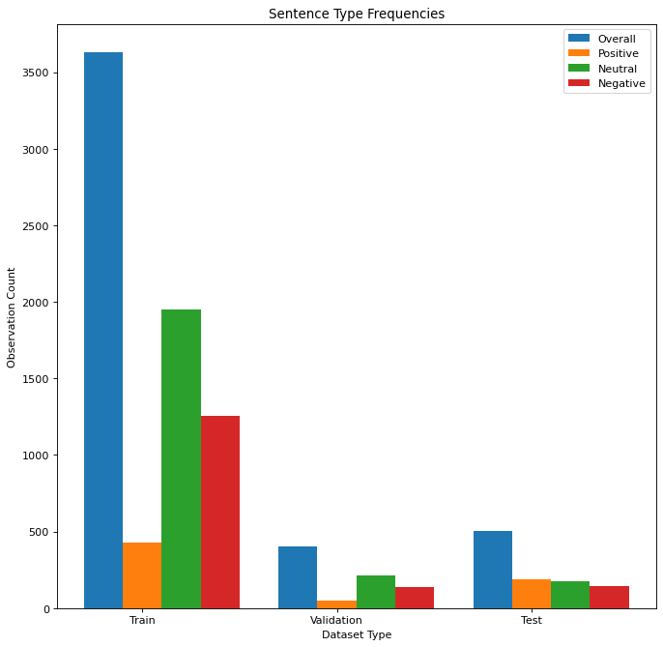
Problem and Topic
Interested in classifying sentences within 10-k filings
10-k has five main components
Business, risk factors, financial data, financial conditions and sentiment, and financial statements
We scrape sentences from all components
Create custom data-set of 10-k sentences from Apple, Amazon, Ebay, Facebook, Microsoft, and Tesla
Focus on big named companies
Although 10-k filing language is very similar across companies
Split into train, validation, test see right figure
Run FinBERT, a domain specific classification model as a baseline and fine-tune it to our additional dataset to compare

Slide 2
Hypothesis and Novel Methods
Using these custom labelled sentences, we fine-tune the original base FinBERT model on 10-k sentences
We want to test if domain specific knowledge/sentences can better predict sentence-level sentiment
We find that we can marginally out-perform the baseline using these sentences
We follow Chi et al. to perform our fine-tuning
Vary hidden layer size, activation, and learning rate
Use Layer-wise Decreasing Layer Rate
Test different values of number of attention heads
We note FinBERT is trained to perform well on many different tasks, with the cost that it may not be as good on any one particular task
This is why fine-tuning specific to 10-k filings is expected to out-perform on 10-k classification itself

Slide 3
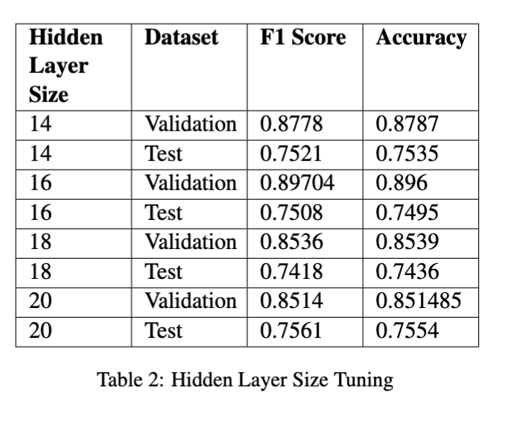
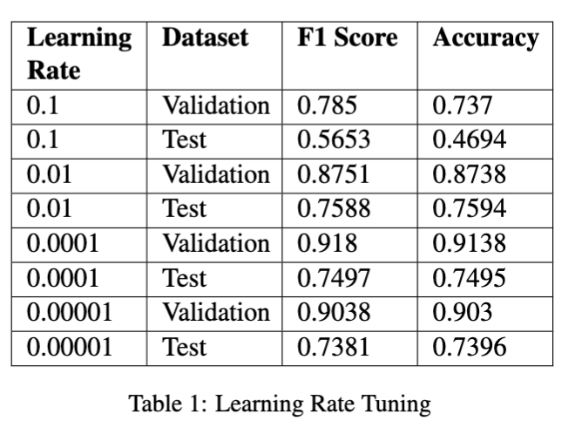
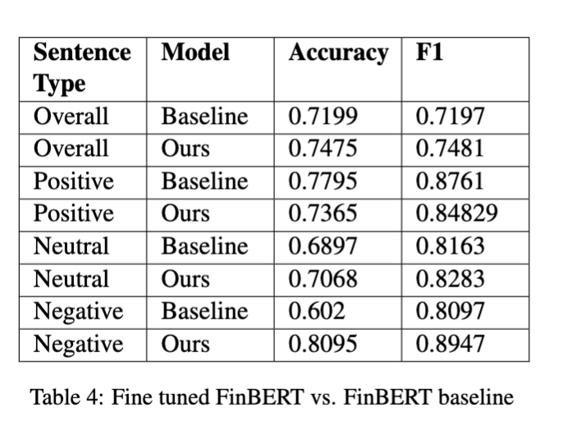
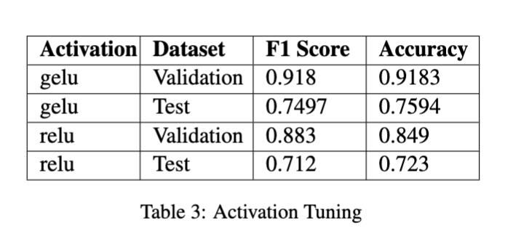
Results and Analysis

